Slide 1



Application Workshop
Housing and Human Services Department
Community Development Block Grant (CDBG)
December 14, 2023

Slide 2
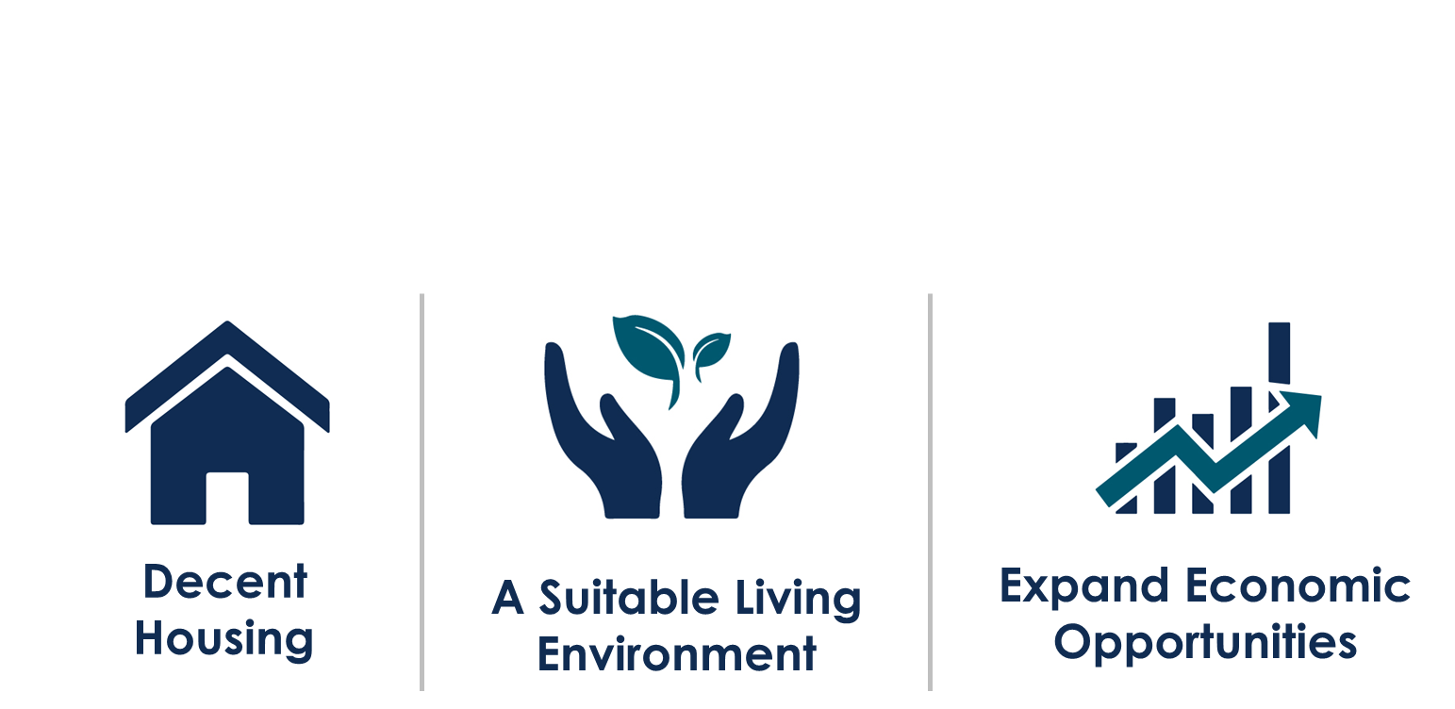
CDBG Program Goals
The CDBG Program is Implemented in support of HUD’s
Three Community Development Goals:

Slide 3
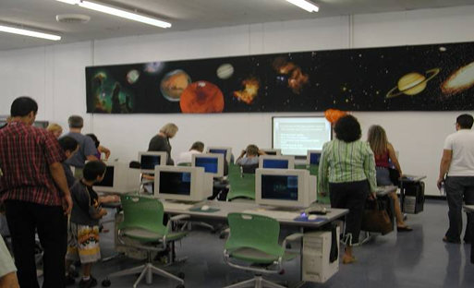
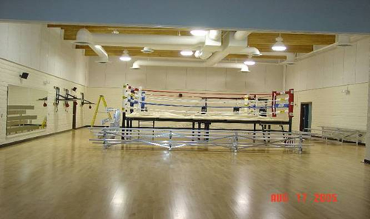
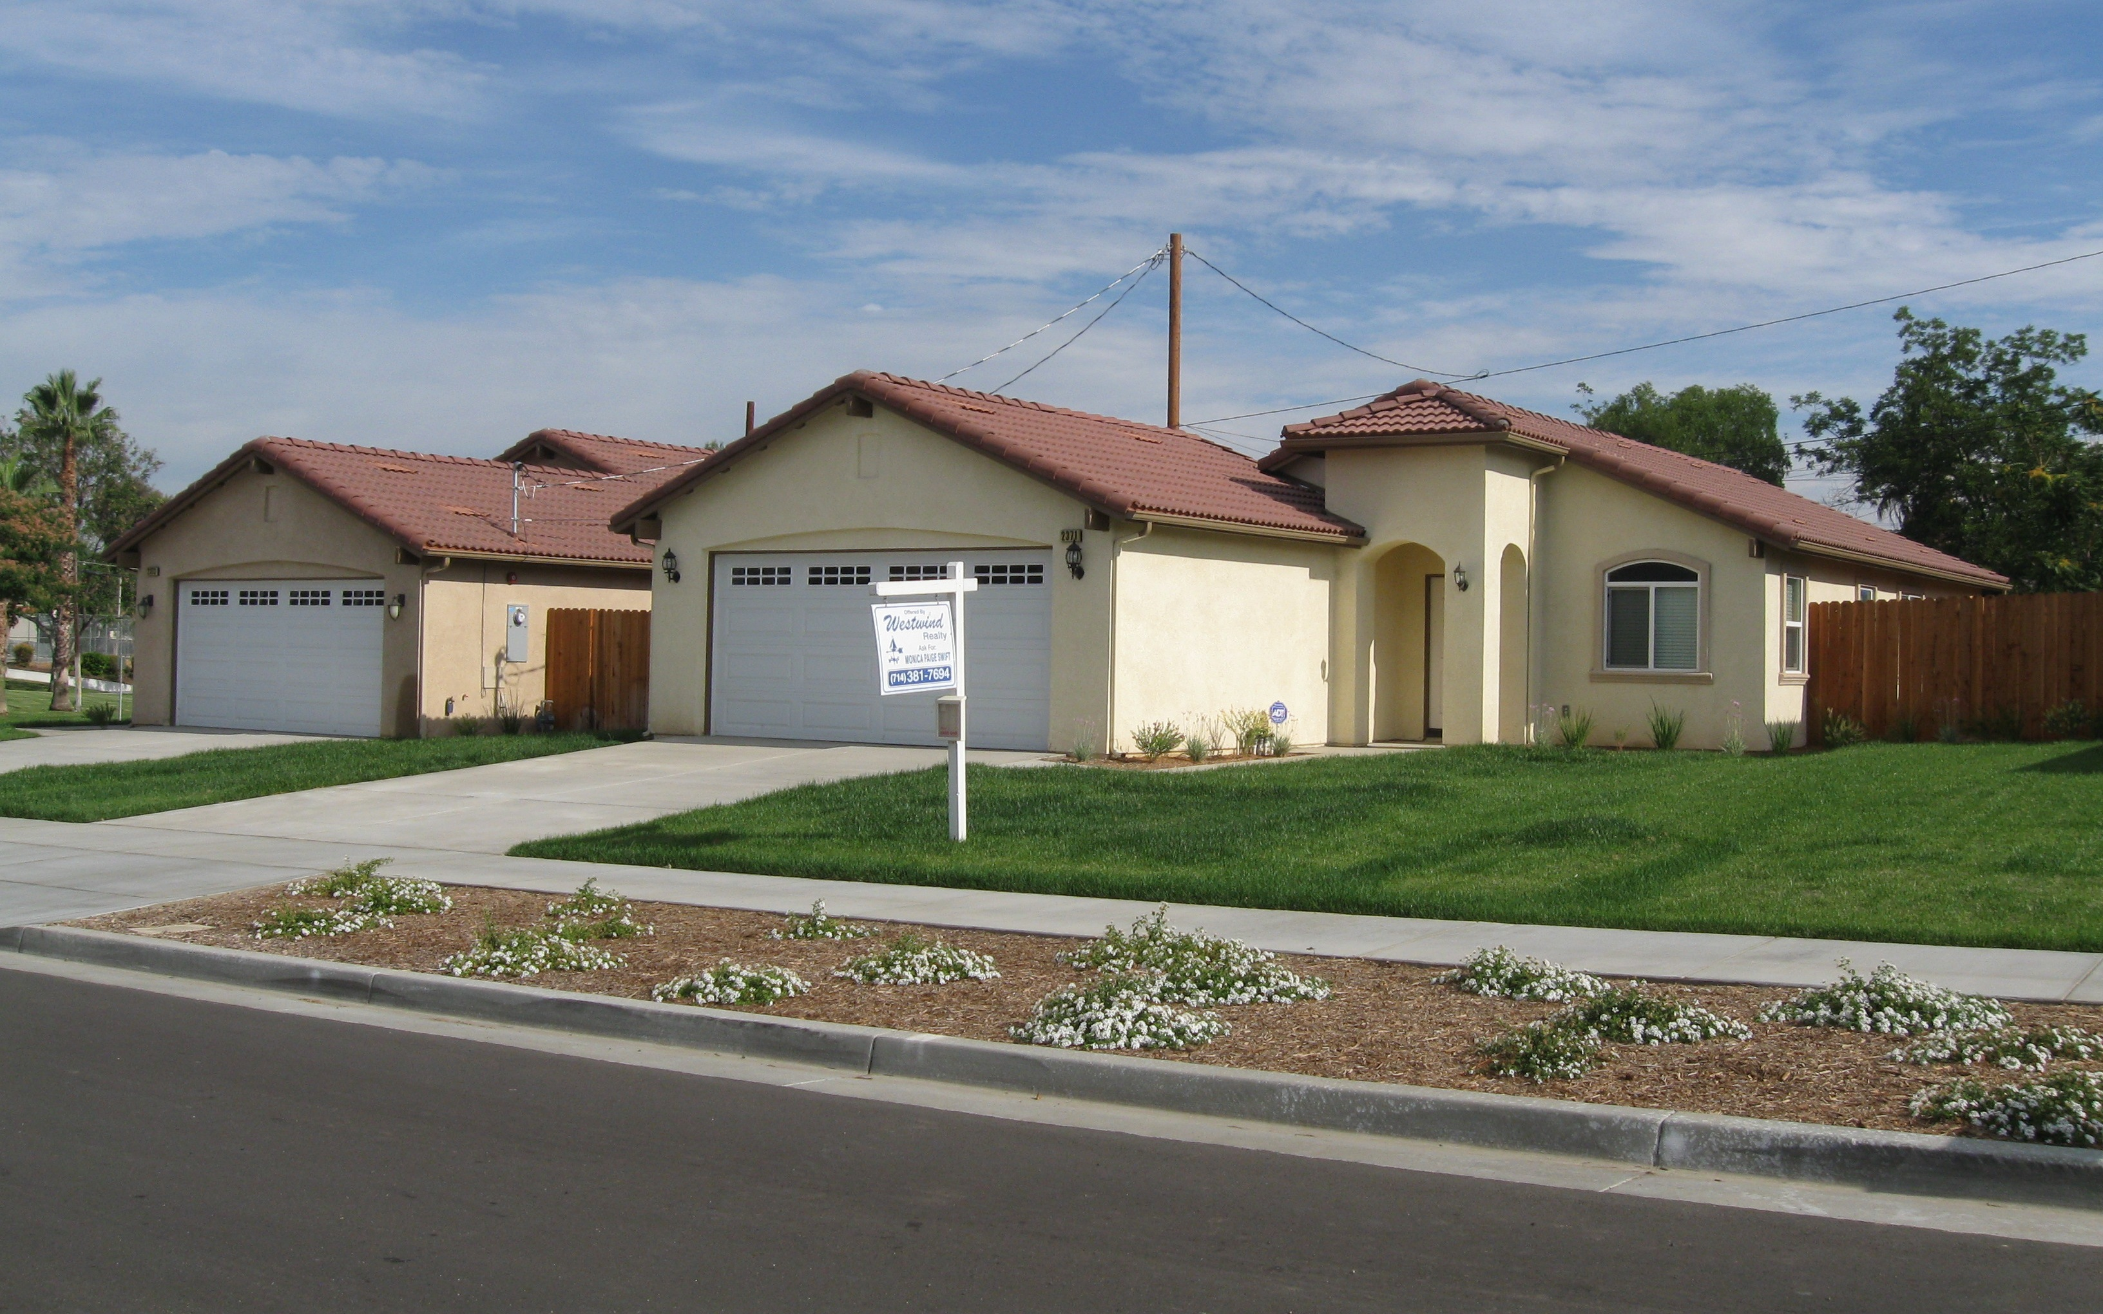
CDBG Program Goals
National Objectives
Benefit Low/Moderate Income Persons
Prevent/Eliminate Slum and Blight
Address an urgent community need

Slide 4
2023-2024 FUNDING FROM HUD
Funding Breakdown
Public Service Projects | 15%
Capital Improvement Projects (Approximate) | 65%
Administration | 20%
$2,863,437

Slide 5
CDBG Eligibility Categories
Low- Moderate Income Area Benefit
51% of residents are low- and moderate-income
Low- Moderate-Income Clientele
Require documentation to show at least 51% of clientele served are low-moderate-income
Clientele generally presumed to be low-moderate-income (Limited Clientele)
Low- Moderate-Income Housing Activity
Providing or improving permanent residential structure(s) for low-moderate-income persons
Low- Moderate Income Job Creation/Retention
Create/retain permanent jobs
Notes:
Change income

Slide 6
CDBG Program Guidelines
How is “Low” and “Moderate” Income Defined?
Person(s) | 1 | 2 | 3 | 4 | 5 | 6 | 7 | 8
Extremely Low (30%) Income | $19,600 | $22,400 | $25,200 | $30,000 | $35,140 | $40,280 | $45,420 | $50,560
Very Low (50%) Income | $32,650 | $37,300 | $41,950 | $46,600 | $50,350 | $54,100 | $57,800 | $61,500
Low Income (80%) | $52,200 | $59,650 | $67,100 | $74,550 | $80,550 | $86,500 | $92,450 | $98,450
HUD Income Limits 2023

Slide 7
CDBG Program Guidelines
How is “Presumed Benefit” Defined
Abused Children
Severely disabled adults
Elderly (62 + years)
Illiterate adults
Battered Spouses
Migrant farm workers
Homeless Persons
Persons Living with HIV/AIDS
Notes:
“Presumed "Low Moderate Income Persons:
Abused Children
Elderly (62 + years)
Battered Spouses
Homeless Persons
Severely disabled adults
Illiterate adults
Migrant farm workers

Slide 8
Eligible CDBG Applicants
Registered 501(c)(3) or (6) Non-profit Organization
Government entity
UEI
Educational institution
Licensed/Certified to operate facility/program
Funding used to serve residents of the City of Riverside
Demonstrate financial/organizational capacity to implement project
Capacity to successfully implement project between July ’24 and June ’25

Slide 9
Successful CDBG Applicants
Successful Applicants will enter into an Agreement with the City
City will provide funds only on a reimbursement basis (No reimbursements for debt incurred before July 1)
Quarterly Compliance reports required
Funding must be spent between July 1, 2024, and June 30, 2025
Must be able to document client eligibility

Slide 10
Ineligible CDBG Activities
General Government Expenses
General Administrative Activities
Indirect organizational costs
Political Activities
Campaign Event for a candidate
Purchase of equipment
Bulldozer for new construction project
Expenses incurred
Prior to award on July 1, 2024

Slide 11
Eligible CDBG Activities
Capital Improvement Projects:
Construction and/or improvements to community facilities; curb, gutter, and sidewalk improvements and street rehabilitation, etc.
Economic Development:
Job creation, job training, commercial improvements, etc.
Public Service (15% Cap):
After-school and childcare programs, health and substance abuse services, homeless services, anti-crime programs, code enforcement

Slide 12
Capital Improvement Projects
  Nonprofit must own the facility being built or improved
  Nonprofit must provide services targeted to low- moderate-income residents of Riverside
  Facility must be open to the public during normal business hours
  Demonstrate financial/organizational capacity to implement project
  Capacity to successfully implement project
between July ’24 and June ‘25

Slide 13
Capital Improvement Projects cont.
Proposal from Licensed Contractor:
Accurate Work Description
Line-item cost estimates
Construction plans and specifications
City fees for plan review and required permits
Proper insurance coverage
Include HUD regulations that may increase project costs:
Federal Labor Standards Provisions
Davis-Bacon Prevailing Wages
Current Federal Wage Determination
Weekly Certified Payrolls

Slide 14
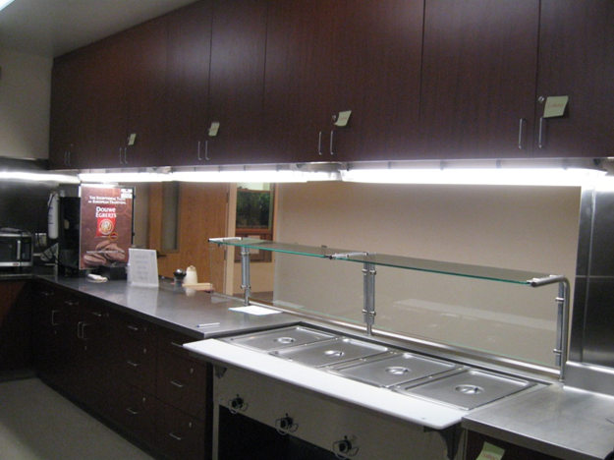
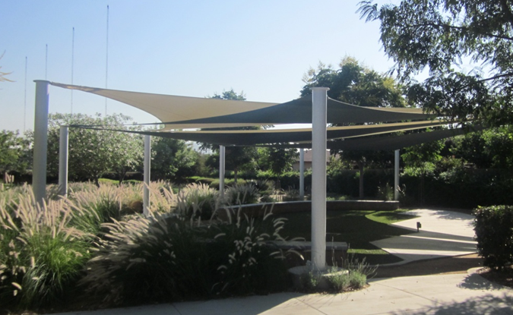
Eligible Capital Improvement Projects
Construction, reconstruction, rehabilitation, installation, and demolition
Playgrounds and shade structures;
Sewer lines, parking lots, hardscape
Janet Goeske Senior Center Kitchen Remodel
Casa Blanca Shade Structure

Slide 15
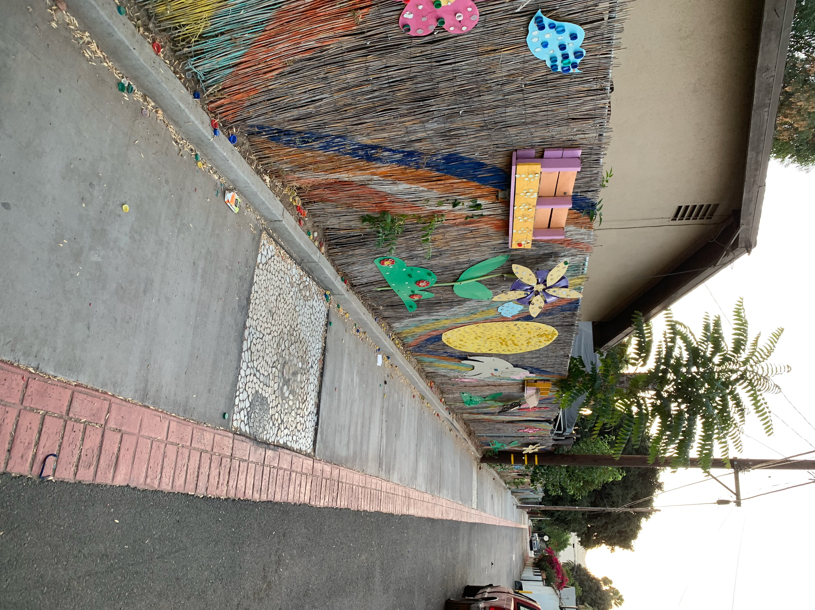
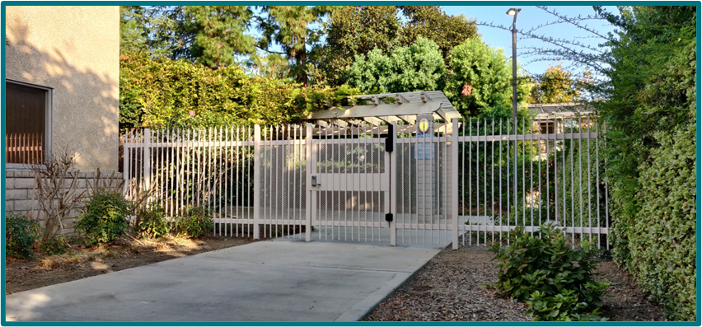
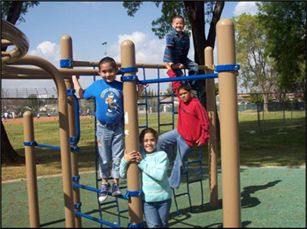
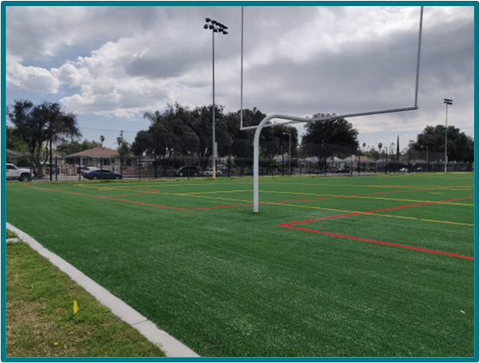
Eligible Capital Improvement Projects cont.
Safe Pathways
for Schools
Security Fencing at Janet Goeske Senior Center
Artificial Turf Installation at Bobby Bonds Park

Slide 16
Public Service Activities
Local nonprofits use CDBG funds for programs such as:
Childcare
Youth and teen programs
Shelters for victims of domestic violence and the homeless
Services for the elderly and the disabled
Substance abuse services
Applicant must do the following:
Successfully implement project between July ’24 and June ’25
Financially sustain the program while waiting for reimbursement
Implement a consistent intake process to track participants

Slide 17
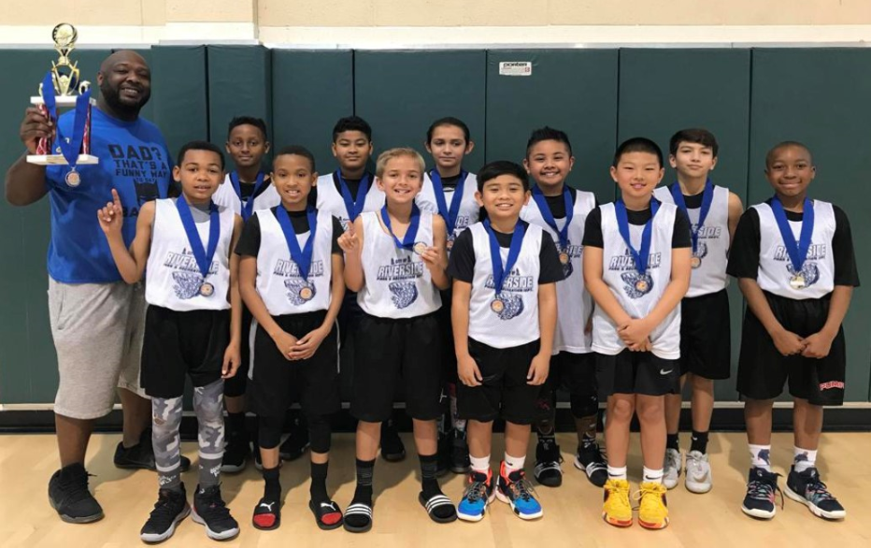
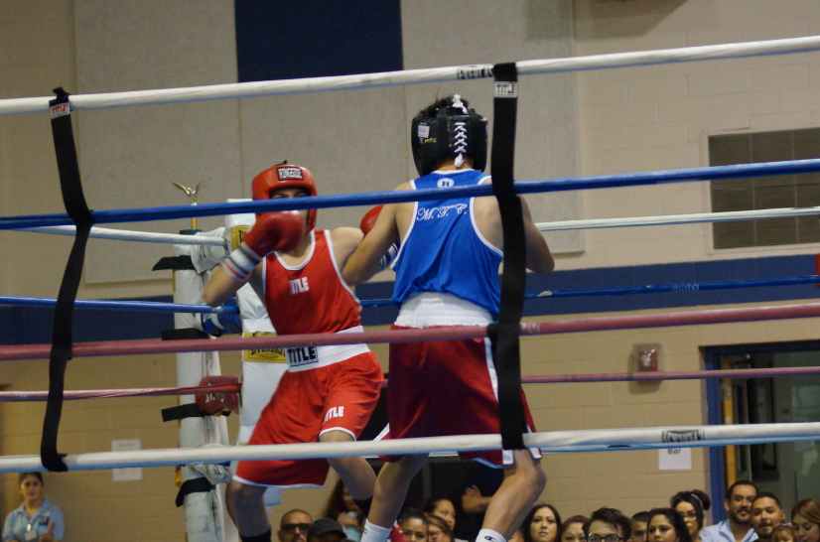
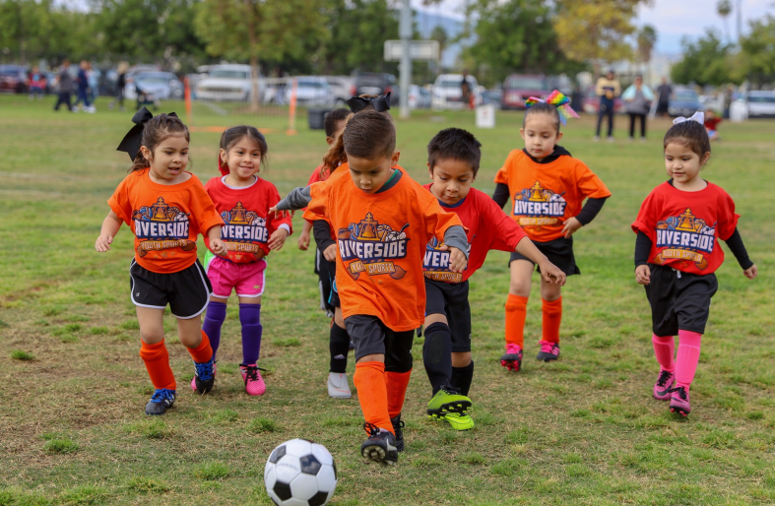
Example of Public Service Activities
Youth Sports PRCS

Slide 18
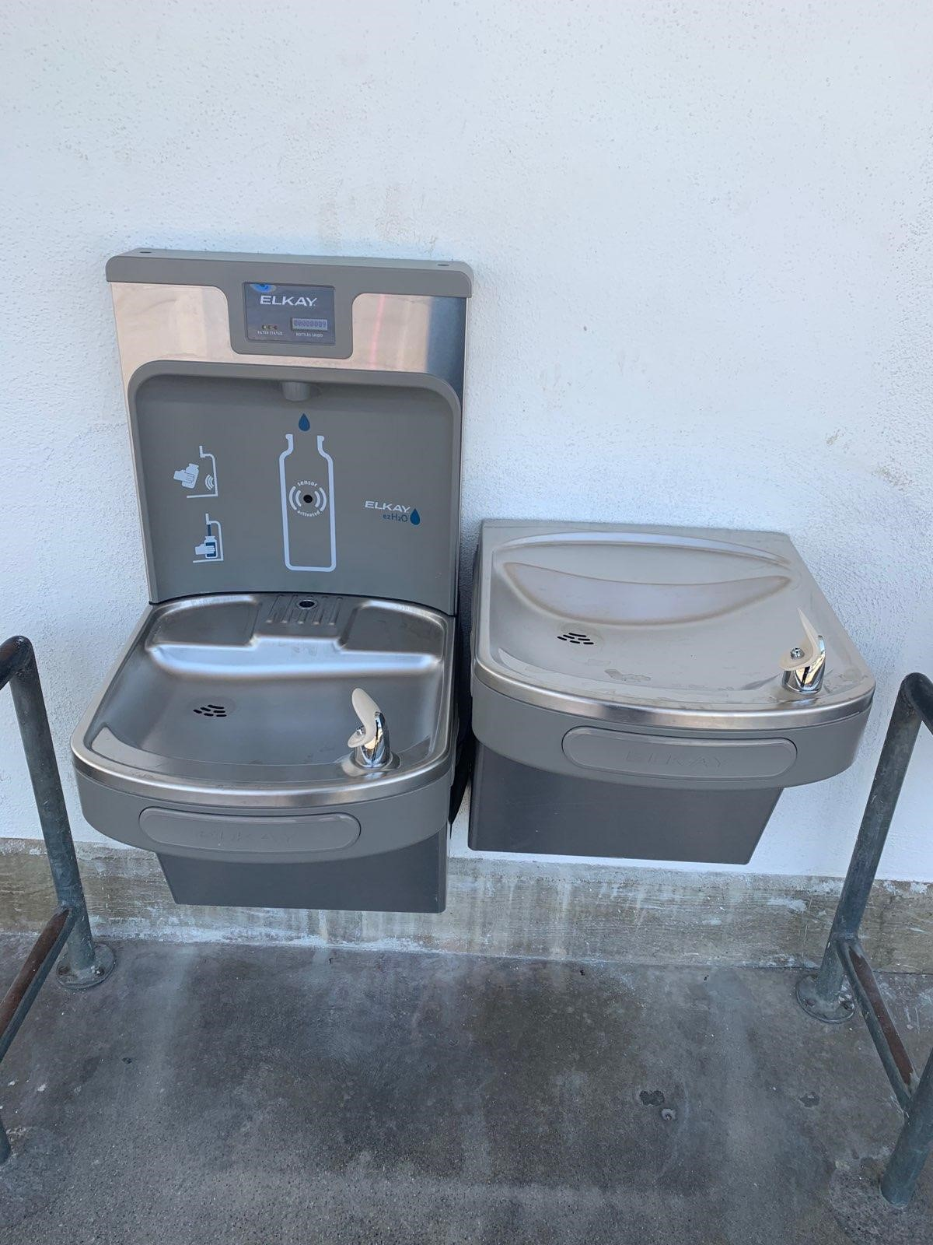
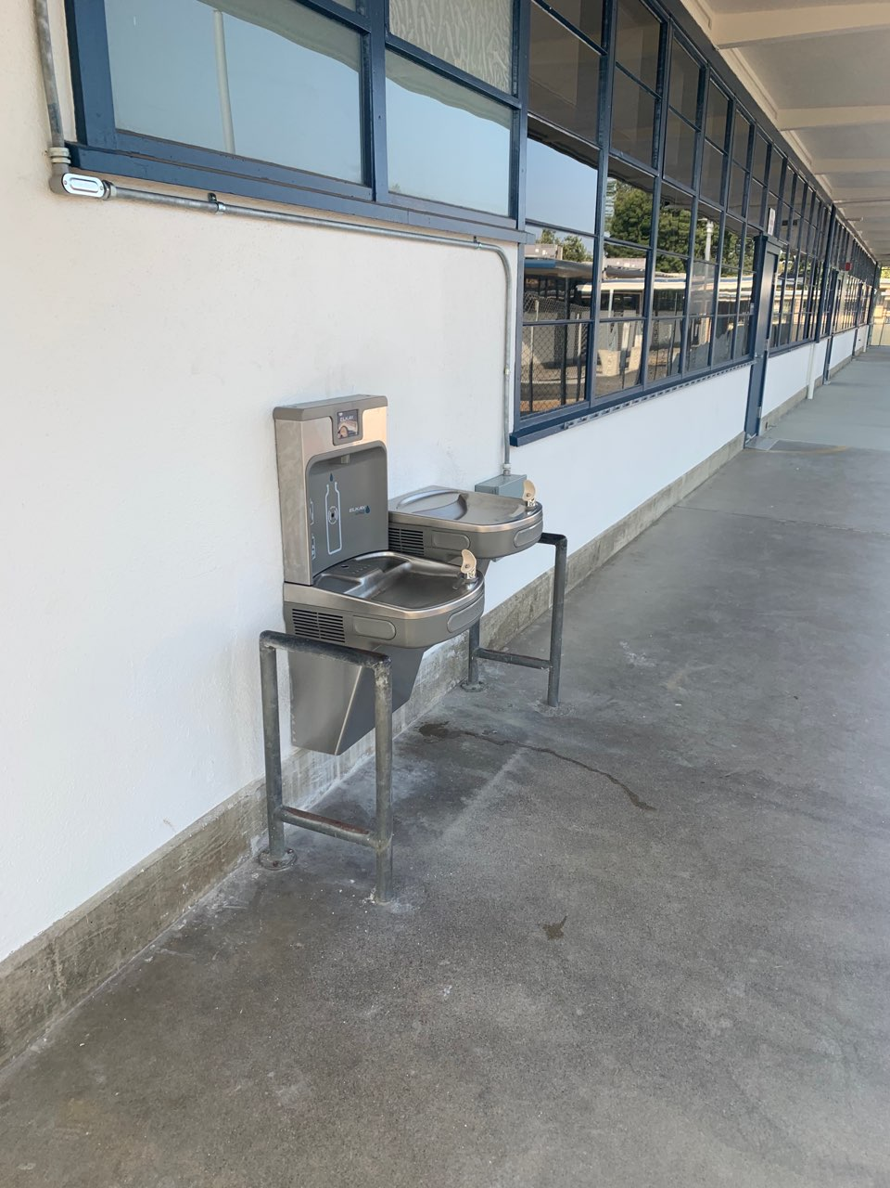
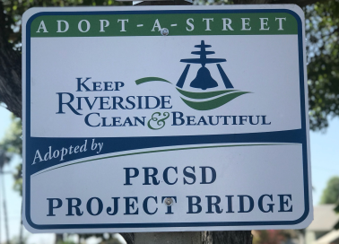
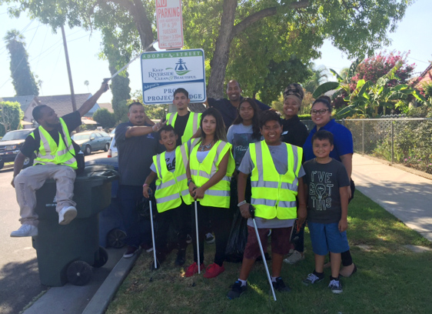
Example of Public Service Activities Cont.
Hydration Station- Madison Elementary
Project Bridge
Adopt a Street

Slide 19
CDBG Application Process
2023-2024 Calendar
October - November 2023 | Community Budget Meetings
December 2023 | Release of application
February-March 2024 | Application Review
May 2024 | Action Plan Funding Recommendations Released for Public Review
June 2024 | Public Hearing on Recommendations and Final City Council Approval
June 2024 | Submittal to the Housing & Urban Development Department (HUD)

Slide 20
CDBG Application Process
Applicant/Project Information
HUD CDBG National Objectives Criteria and Outcomes Measurements
CDBG Application Narrative Section
CDBG Project Budget FY 2024-2025 for Public Service Activities
CDBG Project Budget FY 2024-2025 for Capital Development Activities
Maintenance and Operation Commitment
Insurance Requirements
References
Applicant Certification
CDBG Application Attachments
Application Submittal

Slide 21
CDBG Application Process
CDBG Application Submittal
  Application Release - December 6, 2023
  Due Date: Wednesday, January 24, 2024, 4:00 pm
  One original and two copies
  Housing and Human Services Department,
  3900 Main Street, 5th Floor
  No E-Mail Submissions
  Application must be complete to be evaluated

Slide 22
CDBG Technical Assistance
Housing and Human Services Department
CDBG/Grants Division
Michelle Guzman
- Capital Improvement Projects, Public Service, and HOPWA 951-826-5302
Martha Naranjo
- Capital Improvement Projects and HOPWA 951-826-5469
Johanna Escobar
- Public Service Projects 951-826-2040

Slide 23

CDBG Technical Assistance
Questions?
Please provide your input!
Community & Economic Development Department
FedGrants@RiversideCA.gov
(951) 826-2438

